Slide 1
AC6761 Artificial Intelligence Accounting
Chapter 1 Accounting in Business
Dr. Kevin ZHU
Office: AC3 13-218
Phone: 3442 4763
Email: xindozhu@cityu.edu.hk

Slide 2
Assessment
Group project (20%)
requirement:
3-5 students per group
Name list should be submitted before the end of week 3
The written report (10%) should be submitted at the end of week 13
Each of team member has to participate in group presentation (around 25-30 minutes; 10%)
Class participation (10%) – In class discussion, individual assignment or case solution
Midterm (20%) – Closed book (Week 7, Oct 14, 19:30-21:30; AC1 (Yeung) – Y4302 & Y4702)
Final (50%) – Closed book
You must pass both the Coursework (including group project, class participation and Midterm) and the Final in order to pass the course.

Slide 3
Course structure
Traditional financial reporting system – Double-entry bookkeeping system (Mainstream)
Integrated enterprise information system – REA model (Another perspective)
Applications of AI in accounting (Financial statement / Annual report analyses)

Slide 4
Schedule
Introduction of Double-Entry Bookkeeping system (Week 1 – Week 3)
Introduction of REA model (Week 4 – Week 5)
Database design and query with ACCESS (Week 6)
Mid-term test (Week 7)
Introduction of Artificial Intelligence (Week 8)
AI in financial statement / annual report analyses (Week 9 – Week 10)
Hands-on AI application, ethical considerations and future trends of AI (Week 11)
Group presentations (Week 12 – Week 13)

Slide 5
AI Accounting

Slide 6
A common misconception
Just throw the financial statements at AI and let it analyse them.
AI is a powerful amplifier, but only when you already understand the numbers.

Slide 7
Why accounting fundamentals come first
You must speak the language. Revenue recognition, accruals, depreciation, working capital, leverage — AI uses these terms. You need to know what they actually mean.
Statements are interconnected. Income Statement, Balance Sheet, Cash Flow. A change in one place must reconcile elsewhere. AI can miss or invent these links.
Judgment is still human. Accounting estimates, aggressive policies, off-balance-sheet items, and creative presentation require professional skepticism.
You become the quality filter. AI can hallucinate ratios, invent trends, or overlook footnotes.

Slide 8
What you must be able to do before AI helps
Read the financial statements.
Compute and interpret key ratios.
Trace the story across industries or years.
Read the footnote and MD&A.
Spot red flags.
Form a view, then test it.

Slide 9
Explain the purpose and importance of accounting.

Slide 10
What is Accounting
Language of Business
An information and measurement system that...
  Identifies, records and communicates
  relevant, reliable, and comparable information
  about an organization’s business activities

Slide 11
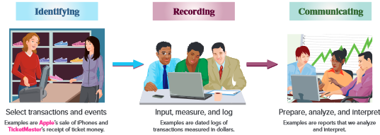
Importance of Accounting
For example, the sale by Apple of an iPhone.
Keep a log of transactions.
Prepare reports such as financial statements.

Slide 12

For example
Tom wants to run a bakery.
He borrows money from friends as capital.

Slide 13
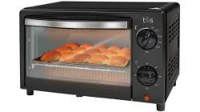
For example
Identifies the asset
  oven
Record the asset
  Equipment– oven, $1200
Communicate
  provide financial information to friends
  How many assets at hand?
  How much I earn during the past one year?

Slide 14
Identify users and uses of accounting.

Slide 15
Users of Accounting Information
Accounting is called the language of business because all organizations set up an accounting information system to communicate data to help people make better decisions.
Accounting serves many users who can be divided into two groups: external users and internal users.

Slide 16


In our example
External user
  Tom’s friends
  How much returns?
  How about the future performance?
Internal user
  Tom and his team
  How to improve the efficiency?
  How much is the cost?

Slide 17
Users of Accounting Information
Investors use accounting information in valuing stocks
Bankers rely on accounting information in deciding whether to lend money to a business and in assessing the risk of the loan
Managers use accounting information in making investment decisions.
Managers use accounting information in evaluating the performance of employees at various levels of an organization
….

Slide 18
Types of Accounting Information
Financial Accounting
  Provides information primarily to people outside the company (e.g., investors and creditors), through general-purpose financial statements.
Management Accounting
  Provide information to people inside the company (e.g., managers)
Tax Accounting
  Provides information to the tax authorities

Slide 19
Explain why ethics are crucial to accounting.

Slide 20
Ethics - A Key Concept
Ethics
Beliefs that distinguish right from wrong
Accepted standards of good and bad behavior

Slide 21
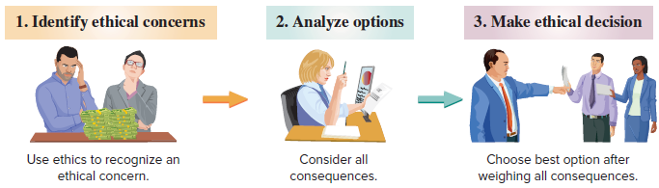
Ethics – A Key Concept
The goal of accounting is to provide useful information for decisions. For information to be useful, it must be trusted. This demands ethics in accounting. Ethics are beliefs that distinguish right from wrong. They are accepted standards of good and bad behavior.

Slide 22
Enron Scandal
Enron Corporation was an American engergy company based in Houston, Texas.
Before its bankruptcy in late 2001, Enron employed approximately 22,000 people and Fortune named Enron "America's Most Innovative Company" for six consecutive years.
After a series of revelations involving irregular accounting procedures conducted throughout the 1990s, Enron shares dropped from over US$90.00 to less than 50¢. Enron filed for bankruptcy on December 2, 2001.
In addition, the scandal caused the dissolution of Arthur Andersen.
@

Slide 23



Big 5 -> Big 4 Audit Firms
AA did not fulfill its professional responsibilities in connection with its audits of Enron's financial statements
Convicted of obstruction of justice for shredding documents related to its audit of Enron
Arthur Andersen, Ernst ＆ Young, Deloitte Touch, PWC, KPMG

Slide 24
WorldCom Scandal
WorldCom began in 1983 as a small company. Within 15 years it became one of the largest telecommunication company in the world (20 million customers, 55,000 employees)
In late June 2002, WorldCom stunned investors by announcing that it intended to restate its financial statements for 2001 and 2002 Q1. According to the press release, an internal audit had uncovered $3.8 billion in improper transfers from line cost expenses to the balance sheet
Trading in the company’ stock was immediately halted on the exchange.
When trading resumed a few days later, the stock was worth only 6 cents per share having lost more than 90% of its value

Slide 25
Olympus hotline didn’t blow whistle
January 5, 2012
The Wall Street Journal has learned that Hideo Yamada and Hisashi Mori, the two Olympus executives who allegedly concealed $1.5 billion in losses, also oversaw the Japanese camera maker’s whistleblowing hotline.
According to a recent report by an independent panel charged with investigating the cover-up, the company had a corporate culture in which employees “were afraid to express views that were different” from those held by its leadership.
The Journal concludes, “Reforming Olympus’s corporate governance will be a key issue in the coming weeks as the scandal-ridden company gears up for an extraordinary shareholders’ meeting as early as March — and a possible battle there over who should lead the company through the reform.”

Slide 26
Sarbanes–Oxley (SOX)
In 2002, U.S. congress passed the Sarbanes-Oxley Act to help curb financial abuses at companies that issue their stock to the public.
SOX requires documentation and verification of internal controls and emphasizes effective internal controls.
Management must issue a report stating that internal control are effective.
Auditors must verify the effectiveness of internal controls.
Failure to comply can lead to penalties and criminal prosecution of executives.
https://www.investopedia.com/terms/s/sarbanesoxleyact.asp
© McGraw-Hill Education

Slide 27
Explain generally accepted accounting principles and define and apply several accounting principles.

Slide 28
Generally Accepted
Accounting Principles (GAAP)
Financial accounting is governed by concepts and rules known as generally accepted accounting principles (GAAP). GAAP aims to make information relevant, reliable, and comparable.
Reliable information is trusted by users.
Relevant information affects decisions
of users.
Comparable information is helpful in contrasting organizations.

Slide 29
Setting Accounting Standards
In U.S, Financial accounting practice is governed by concepts and rules known as Generally Accepted Accounting Principles (GAAP).
Many countries have adopted or are planning to adopt
International Financial Reporting Standard (IFRSs)
For example:
The European Union (EU) - January 1, 2005
Hong Kong - January 1, 2005
P.R. China – January 1, 2007
http://www.pwc.com/us/en/issues/ifrs-reporting/country-adoption/index.jhtml
The FASB (Financial Accounting Standards Board) and the IASB (The International Accounting Standards Board ) have agreed to work toward harmonization.

Slide 30
International Standards
In today’s global economy, there is increased demand by external users for comparability in accounting reports.
International Accounting Standards Board (IASB)
Issues International Financial Reporting Standards (IFRS)
International Financial Reporting Standards (IFRS)
Identify preferred accounting practices

Slide 31
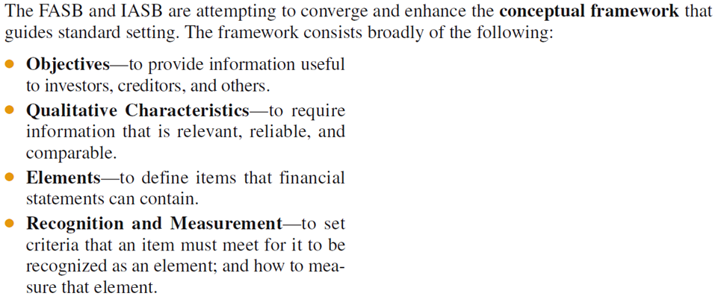
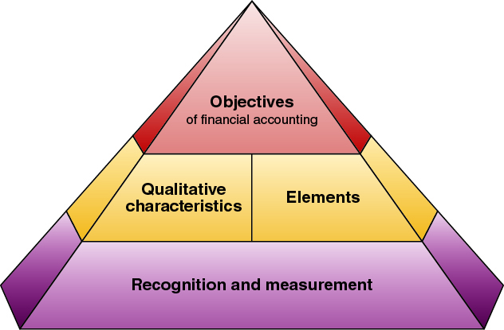
Conceptual Framework

Slide 32
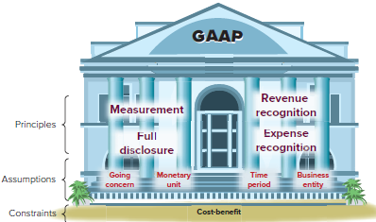
Principles, Assumptions and Constraint
General principles are the assumptions, concepts, and guidelines for preparing financial statements.
Specific principles are detailed rules used in reporting business transactions and events.

Slide 33
Accounting Principles
Measurement Principle
(Cost Principle)
Accounting information is based on actual cost. Actual cost is considered objective.
Revenue Recognition Principle
Recognize revenue when goods or services are provided to customers and
at an amount expected to be received from the customer.
Expense Recognition Principle
(Matching Principle)
A company records its expenses incurred to generate the revenue reported.
Full Disclosure Principle
A company reports the details behind financial statements that would impact users’ decisions in the notes to the financial statements.

Slide 34
Accounting Assumptions
Going-Concern Assumption
The business is presumed to continue operating instead of being closed or sold.
Monetary Unit Assumption
Transactions and events are expressed in monetary, or
money, units.
Business Entity Assumption
A business is accounted for separately from other business entities, including its owner.
Time Period Assumption
The life of a company
can be divided into time periods,
such as months and years.

Slide 35
Corporation
Owners of a corporation or company are called
shareholders (or stockholders). Shareholders are not personally liable for corporate acts. When a corporation issues only one class of shares, we
call it ordinary shares (or common stock).

Slide 36
Accounting Constraint
Cost-benefit
Only information with benefits of disclosure greater than the cost need be disclosed.
Materiality
Only information that would influence the decisions of a reasonable person need be disclosed.

Slide 37
Define and interpret the accounting equation and each of its components.

Slide 38

The Accounting Equation
=
+
Assets
Liabilities
Equity
Assets - Liabilities = Equity
“own” “owe” “owners’ share of the business”
(residual claim)

Slide 39
Assets
Cash
Accounts Receivable
Notes Receivable
Resources owned or controlled by a company expected to yield future benefits.
Vehicles
Land
Buildings
Store Supplies
Equipment

Slide 40
Liabilities
Accounts Payable
Unearned revenue
Creditors’ claims on assets that represents an obligation to make future payment
Wages Payable
Taxes Payable

Slide 41
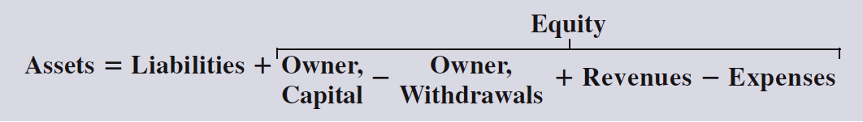
Equity
Owner’s Claims on Assets
Owner’s equity is also called net assets or residual equity.

Slide 42
Expanded Accounting Equation
=
+
=
+
Assets
Liabilities
Equity
Assets
Liabilities
Equity
_
_
Owner Capital
Owner Withdrawals
+
Revenues
Expenses
Owner's Equity

Slide 43
REVENUES
Revenues is an increase in owners’ equity from providing goods or services.
Revenue is recognized when both:
  It is earned (i.e., goods or services are provided) and
  It is realized or realizable (i.e., payment for goods or services received in cash or something that can be converted to a known amount of cash)
These conditions are called revenue recognition criteria.

Slide 44
EXPENSES
Expenses are decreases in owners’ equity that arises in the process of generating revenues
Expenses are recognized when either:
  Related revenues are recognized (product costs) or
  Incurred to support revenue generation (period costs)
These underlying recognition concepts are the matching principle
An expense represents the ​​cost of operations​​ that a company incurs to ​​generate revenue in a specific period​​.

Slide 45
Reporting Ownership Equity
Sole Proprietorships
Partnerships
Corporations

Slide 46
Stockholders’ Equity of a Corporation
Paid-in Capital = owners’ investment
Retained Earnings:
Cumulative net income (and loss) not distributed as dividends to its stockholders.
Beginning Retained Earnings
+ Revenues
- Expenses
- Dividends
= Ending Retained Earnings

Slide 47
Expanded Accounting Equation
Example #1: Owner’s withdrawals
Year |  | Description | Owners’ Equity (OE) | Owners’ Equity (OE) -Capital Stock -Retained earnings
2013 | Yr1 | Owner’s contribution 10,000
2014 | Yr2 | Revenue 1,000 Expense 800
2015 | Yr3 | Revenue 2,000 Expense 1,600 Owner’s withdrawals 200

Slide 48
Expanded Accounting Equation
Example #2: Dividend
Year |  | Description | Owners’ Equity (OE) | Owners’ Equity (OE) -Capital Stock -Retained earnings
2013 | Yr1 | Owner’s contribution 10,000
2014 | Yr2 | Revenue 1,000 Expense 800
2015 | Yr3 | Revenue 2,000 Expense 1,600 Dividends 200

Slide 49

Business Transaction and Accounting
The Accounting Equation
=
+
Assets
Liabilities
Equity
Expanded Accounting Equation:
Net Income

Slide 50
Analyze business transactions using the accounting equation.

Slide 51
Transaction Analysis
Business activities can be transactions and events.
Record those that affect the accounting equation and can be reliably measured.
Examples of transactions:
  Selling of products and services (external transactions).
  The business used its supplies, which are reported as expenses (internal transactions).
Examples of events:
  Changes in the market value of certain assets and liabilities and natural events such as floods and fires that destroy assets and create losses.

Slide 52
Transaction Analysis-Rules
Every transaction affects at least two items.
The accounting equation MUST remain in balance after each transaction.
=
+
Assets
Liabilities
Equity

Slide 53
Transaction Analysis-Exercises
Use the accounting equation to analyze the following transactions of FastForward for the month of December 2021.
On December 1, 2021, Chuck Taylor invested $30,000 cash to start a consulting business: FastForward.
purchased supplies paying $2,500 cash.
purchased equipment paying $26,000 cash.
purchased supplies of $7,100 on account from CalTech Supply Co.
provided consulting services receiving $4,200 cash.

Slide 54
Transaction Analysis-Exercises
Paid $1,000 rent to the landlord of the building where its facilities are located.
Paid salary of $700 to its employees.
Provided consulting service of $1600 on credit and rented its test facilities for $300 to a sports club.
Received the cash payment of $1,900 from the sports club ten days later.
Paid CalTech Supply $900 cash as partial payment for its earlier $7,100 purchase of supplies.
Cash dividend to owner of $200.

Slide 55
Transaction 1:
Investment by Owner
Chas Taylor invests $30,000 cash to start a corporation named FastFoward.
The accounts involved are:
(1) Cash (asset)
(2) Common Stock (equity)
Notes:
21

Slide 56
Accounting Equation 1
Chas Taylor invests $30,000 cash to start the business, Fast Forward.
Notes:
21

Slide 57
Transaction 2:
Purchase Supplies for Cash
Company purchased supplies paying $2,500 cash.
The accounts involved are:
(1) Cash (asset)
(2) Supplies (asset)
Notes:
25

Slide 58
Accounting Equation 2
Company purchased supplies paying $2,500 cash.
Accounting Equation must remain in balance!!
Notes:
25

Slide 59
Transaction 3:
Purchase Equipment for Cash
Purchased equipment for $26,000 cash.
The accounts involved are:
(1) Cash (asset)
(2) Equipment (asset)
Notes:
29

Slide 60
Accounting Equation 3
Purchased equipment for $26,000 cash.
Accounting Equation still remains in balance!!
Notes:
29

Slide 61
Transaction 4:
Purchase Supplies on Credit
Purchased supplies of $7,100 on credit.
The accounts involved are:
(1) Supplies (asset)
(2) Accounts Payable (liability)
Notes:
30

Slide 62
Accounting Equation 4
Purchased Supplies of $7,100 on credit.
Accounting Equation still remains in balance!!
Notes:
30

Slide 63
Transaction Analysis: Revenues, Expenses and Dividend
Now, let’s look at transactions involving revenues, expenses and dividends.

Slide 64
Transaction 5:
Provide Services for Cash
Provided consulting services to a customer
and received $4,200 cash right away.
The accounts involved are:
(1) Cash (asset)
(2) Revenues (equity)
Notes:
32

Slide 65
Accounting Equation 5
Provided consulting services to a customer
and received $4,200 cash right away.
Notes:
32

Slide 66
Transactions 6 and 7:
Payment of Expenses in Cash
Paid rent of $1,000 and
salaries of $700 to employees.
The accounts involved are:
(1) Cash (asset)
(2) Rent expense (equity)
(3) Salaries expense (equity)
Remember that the balance in the Expense accounts actually increase.
But, total Equity decreases, because expenses reduce equity.

Slide 67
Accounting Equation 6 and 7
Paid rent of $1,000 and
salaries of $700 to employees.
Remember that expenses decrease equity.

Slide 68
Transaction 8:
Provide Services and Facilities for Credit
Provided consulting services of $1,600 and rents facilities for $300 to a customer for credit.
The accounts involved are:
(1) Accounts receivable (asset)
(2) Consulting Revenues (equity)
(3) Rental Revenue (equity)
Notes:
32

Slide 69
Accounting Equation 8
Provided consulting services of $1,600 and rents facilities for $300 to a customer for credit.

Slide 70
Transaction 9:
Receipt of Cash from Accounts Receivable
Client in transaction 8 pays $1,900 for consulting services and facilities.
The accounts involved are:
(1) Cash (asset)
(2) Accounts receivable (asset)
Notes:
32

Slide 71
Accounting Equation 9
Client in transaction 8 pays $1,900 for consulting services.

Slide 72
Transaction 10:
Payment of Accounts Payable
FastForward pays $900 as partial payment for supplies purchased in transaction 4.
The accounts involved are:
(1) Cash (asset)
(2) Accounts payable (liability)
Notes:
32

Slide 73
Accounting Equation 10
FastForward pays $900 as partial payment for supplies purchased in transaction 4.

Slide 74
Transaction 11:
Payment of Cash Dividend to Shareholders
FastForward pays $200 cash dividend.
The accounts involved are:
(1) Cash (asset)
(2) Dividends (equity)
Remember that the Dividends account actually increases (just like our Expense accounts).
But, total Equity decreases because dividends cause equity to go down!!

Slide 75
Accounting Equation 11
FastForward pays $200 cash dividend.

Slide 76
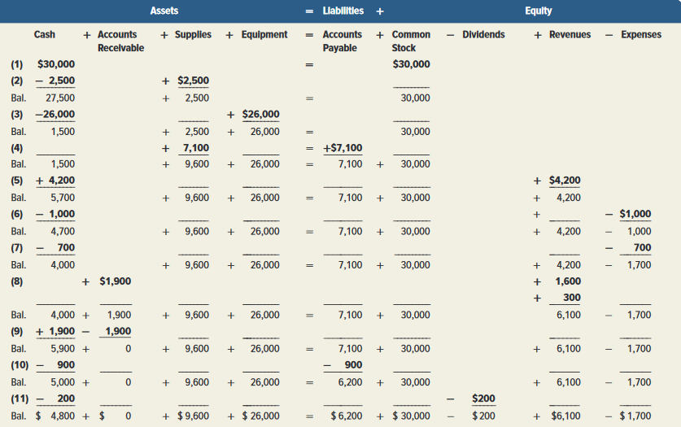
Summary of Transactions

Slide 77
Identify and prepare basic financial statements and explain how they interrelate.

Slide 78
Financial Statements
Let’s prepare the financial statements reflecting the transactions we have recorded.
Income Statement (Statement of Comprehensive Income)
Statement of Changes in Equity
Balance Sheet (Statement of Financial Position)
Statement of Cash Flows

Slide 79
Income Statement
Net income is the difference between Revenues and Expenses.
The income statement describes a company’s revenues and expenses along with the resulting net income or loss over a period of time due to earnings activities.

Slide 80
STATEMENT OF OWNER’S EQUITY
The Statement of owners’ equity reports information about how equity changes over the reporting period.
FastForward
Statement of Owner's Equity
For Month Ended December 31, 2021
C, Taylor, Capital December 1, 2021 |  | $ -
Plus: Investment by owner | $ 30,000
Net income | 4,400
 |  | 34,400
Less: Dividend |  | 200
C. Taylor, Capital, December 31, 2021 |  | $ 34,200

Slide 81
Balance Sheet (Statement of financial position)
The Balance Sheet describes a company’s financial position at a point in time.

Slide 82
Statement of Cash Flows

Slide 83
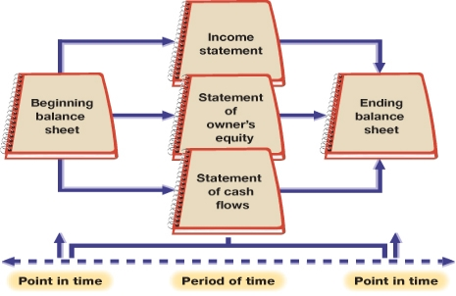
RELATIONSHIPS AMONG FINANCIAL STATEMENTS

